Slide 1
MODERN OPERATING SYSTEMS
Third Edition
ANDREW S. TANENBAUM
Chapter 2
Processes and Threads
Tanenbaum, Modern Operating Systems 3 e, (c) 2008 Prentice-Hall, Inc. All rights reserved. 0-13-6006639

Slide 2
outline
Process
Threads
Process scheduling
Race condition/synchronization

Slide 3
pseudoparallelism
All modern computers do many things at the same time
In a uni-processor system, at any instant, CPU is running only one process
But in a multiprogramming system, CPU switches from processes quickly, running each for tens or hundreds of ms

Slide 4

The Process Model
Figure 2-1. (a) Multiprogramming of four programs. (b) Conceptual model of four independent, sequential processes. (c) Only one program is active at once.
Tanenbaum, Modern Operating Systems 3 e, (c) 2008 Prentice-Hall, Inc. All rights reserved. 0-13-6006639

Slide 5
Advantages and Problems
The parallelism, though a pseudo one, is very beneficial for users
However, every coin has two sides…

Slide 6
Execution non-reproducible
Program A
repeat N:=N+1;
Program B
repeat print(N);N:=0;
Non-reproducible
  Example at an instant, N＝n，if execution sequence is ：
    N:＝N＋1；print(N); N:=0; then, N is:n＋1；n＋1；0
    print(N); N:=0; N:＝N＋1； then N is: n；0；1
    print(N); N:＝N＋1；N:=0; then N is: n；n＋1；0
Another example:
  An I/O process start a tape streamer and wants to read 1st record
  It decides to loop 10,000 time to wait for the streamer to speed up

Slide 7
Difference between Process and Program
Consider an Analogy
A computer scientist baking a cake for his daughter
And his son came in crying for help

Slide 8
Process Creation
Events which cause process creation:
System initialization.
Execution of a process creation system call by a running process.
A user request to create a new process.
Initiation of a batch job.
Tanenbaum, Modern Operating Systems 3 e, (c) 2008 Prentice-Hall, Inc. All rights reserved. 0-13-6006639

Slide 9
Process Termination
Events which cause process termination:
Normal exit (voluntary).
Error exit (voluntary).
Fatal error (involuntary).
Killed by another process (involuntary).
Tanenbaum, Modern Operating Systems 3 e, (c) 2008 Prentice-Hall, Inc. All rights reserved. 0-13-6006639

Slide 10
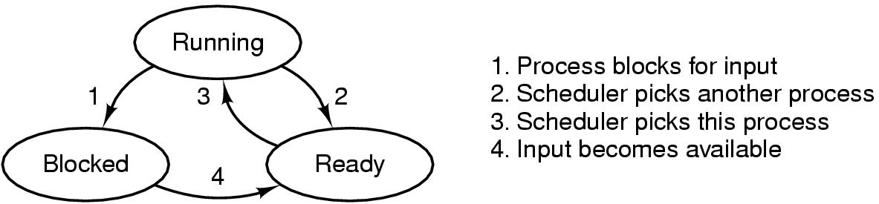
Process States
Figure 2-2. A process can be in running, blocked, or ready state. Transitions between these states are as shown.
Tanenbaum, Modern Operating Systems 3 e, (c) 2008 Prentice-Hall, Inc. All rights reserved. 0-13-6006639

Slide 11
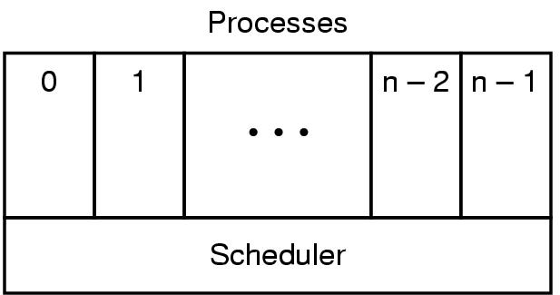
Implementation of Processes (1)
Figure 2-3. The lowest layer of a process-structured operating system handles interrupts and scheduling. Above that layer are sequential processes.
Tanenbaum, Modern Operating Systems 3 e, (c) 2008 Prentice-Hall, Inc. All rights reserved. 0-13-6006639

Slide 12
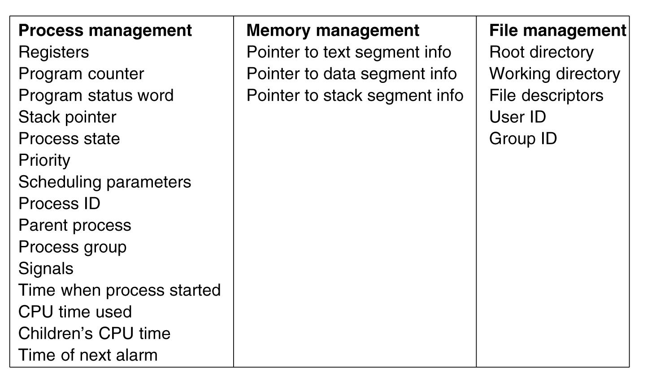
Implementation of Processes (2)
Figure 2-4. Some of the fields of a typical process table entry.
Tanenbaum, Modern Operating Systems 3 e, (c) 2008 Prentice-Hall, Inc. All rights reserved. 0-13-6006639

Slide 13
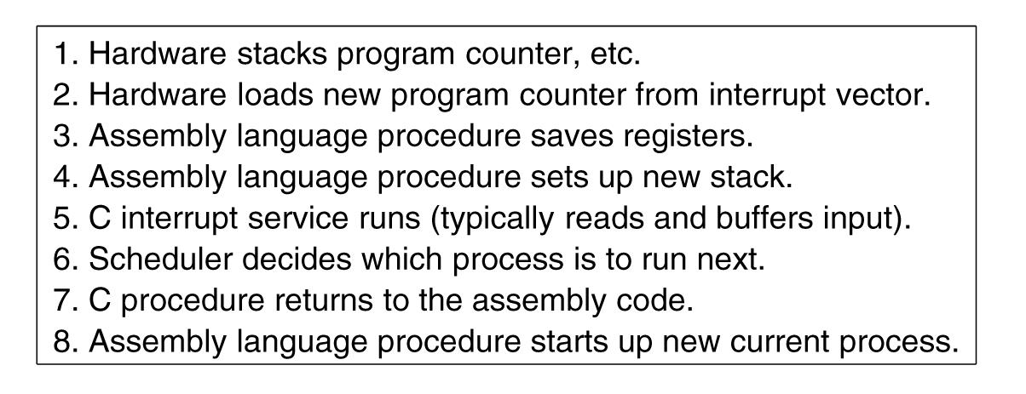
Implementation of Processes (3)
Figure 2-5. Skeleton of what the lowest level of the operating system does when an interrupt occurs.
Tanenbaum, Modern Operating Systems 3 e, (c) 2008 Prentice-Hall, Inc. All rights reserved. 0-13-6006639

Slide 14
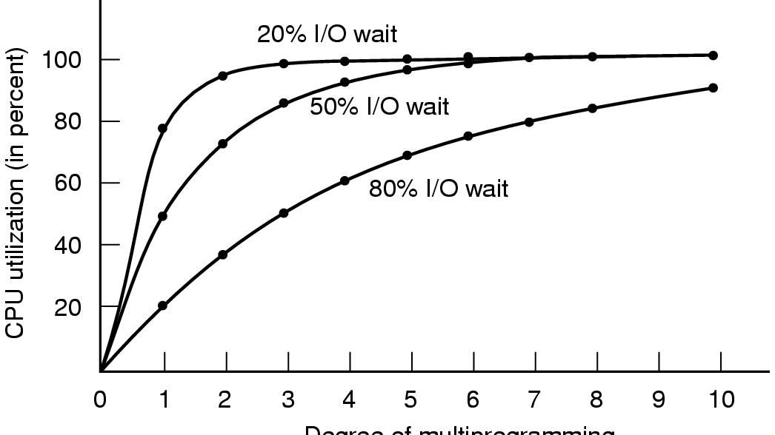
Modeling Multiprogramming
Figure 2-6. CPU utilization as a function of the number of processes in memory.
Tanenbaum, Modern Operating Systems 3 e, (c) 2008 Prentice-Hall, Inc. All rights reserved. 0-13-6006639

Slide 15
summary
Pseudoparallelism
Difference between process and program
Lifecycle of process
Multiprogramming degree

Slide 16

Thread Usage (1)
A word processor with three threads

Slide 17

Thread Usage (2)
A multithreaded Web server

Slide 18
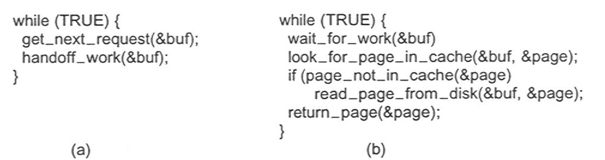
Thread Usage (3)
Rough outline of code for previous slide
  (a) Dispatcher thread
  (b) Worker thread

Slide 19
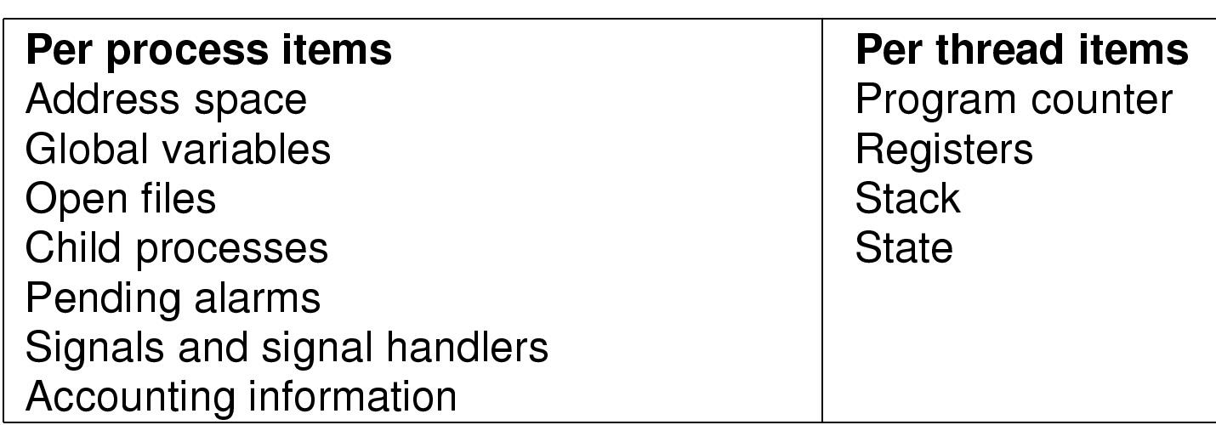
The Thread Model (2)
Items shared by all threads in a process
Items private to each thread

Slide 20
Thread
Has own program counter, register set, stack
Shares code (text), global data, open files
  With other threads within a single Heavy-Weight Process (HWP)
  But not with other HWP’s
May have own PCB
  Depends on operating system
  Context will involve thread ID, program counter, register set, stack pointer
  RAM address space shared with other threads in same process
    Memory management information shared

Slide 21
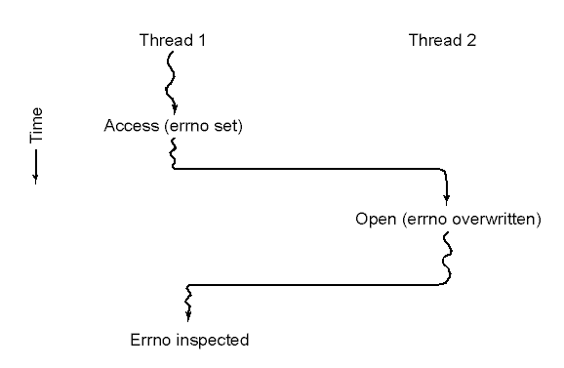
Making Single-Threaded Code Multithreaded (1)
Conflicts between threads over the use of a global variable

Slide 22
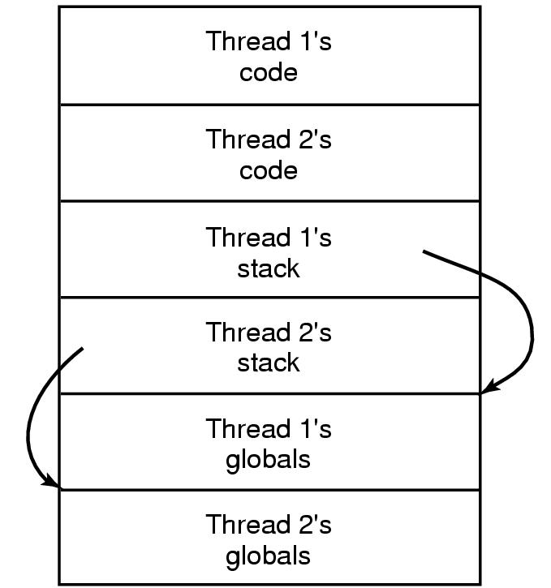
Making Single-Threaded Code Multithreaded (2)
Threads can have private global variables

Slide 23
Threads: Benefits
User responsiveness
  When one thread blocks, another may handle user I/O
  But: depends on threading implementation
Resource sharing: economy
  Memory is shared (i.e., address space shared)
  Open files, sockets shared
Speed
  E.g., Solaris: thread creation about 30x faster than heavyweight process creation; context switch about 5x faster with thread
Utilizing hardware parallelism
  Like heavy weight processes, can also make use of multiprocessor architectures
Notes:
Conditions that make it faster to switch lightweight vs. heavyweight processes?

Slide 24
Threads: Drawbacks
Synchronization
  Access to shared memory or shared variables must be controlled if the memory or variables are changed
  Can add complexity, bugs to program code
  E.g., need to be very careful to avoid race conditions, deadlocks and other problems
Lack of independence
  Threads not independent, within a Heavy-Weight Process (HWP)
  The RAM address space is shared; No memory protection from each other
  The stacks of each thread are intended to be in separate RAM, but if one thread has a problem (e.g., with pointers or array addressing), it could write over the stack of another thread

Slide 25

Interprocess Communication
Race Conditions
Two processes want to access shared memory at same time

Slide 26
Therac-25
Between June 1985 and January 1987, some cancer patients being treated with radiation were injured & killed due to faulty software
  Massive overdoses to 6 patients, killing 3
Software had a race condition associated with command screen
Software was improperly synchronized!!
See also
  p. 340-341 Quinn (2006), Ethics for the Information Age
  Nancy G. Leveson, Clark S. Turner, "An Investigation of the Therac-25 Accidents," Computer, vol. 26, no. 7, pp. 18-41, July 1993
    http://doi.ieeecomputersociety.org/10.1109/MC.1993.274940

Slide 27
Concepts
Race condition
  Two or more processes are reading or writing some shared data and the final result depends on who runs precisely when
  In our former example, the possibilities are various

Slide 28
Concetps
Mutual exclusion
  Prohibit more than one process from reading and writing the shared data at the same time
Critical region
  Part of the program where the shared memory is accessed

Slide 29
Critical Regions (1)
Four conditions to provide mutual exclusion
No two processes simultaneously in critical region
No assumptions made about speeds or numbers of CPUs
No process running outside its critical region may block another process
No process must wait forever to enter its critical region

Slide 30
Critical Section Problem
do {
entry section
critical section
exit section
remainder section
} while (TRUE);
General structure of a typical process P_{i}
Notes:
Draw this on the board!! (So I can have it to refer to when discussing requirements of critical sections)

Slide 31

Critical Regions (2)
Mutual exclusion using critical regions

Slide 32
Mutual Exclusion with Busy Waiting
Disable interrupt
  After entering critical region, disable all interrupts
  Since clock is just an interrupt, no CPU preemption can occur
  Disabling interrupt is useful for OS itself, but not for users…

Slide 33
Mutual Exclusion with busy waiting
Lock variable
  A software solution
  A single, shared variable (lock), before entering critical region, programs test the variable, if 0, no contest; if 1, the critical region is occupied
  What is the problem?
  An analogy: the notepad on the door…

Slide 34
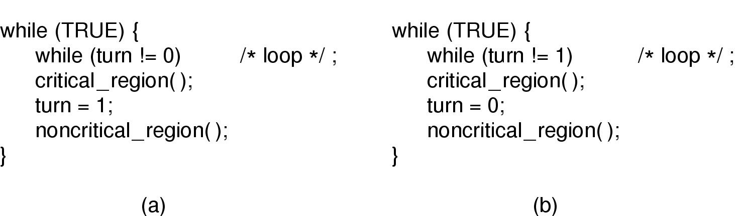
Mutual Exclusion with Busy Waiting : strict alternation
Proposed solution to critical region problem
  (a) Process 0. (b) Process 1.

Slide 35
Concepts
Busy waiting
  Continuously testing a variable until some value appears
Spin lock
  A lock using busy waiting is call a spin lock

Slide 36
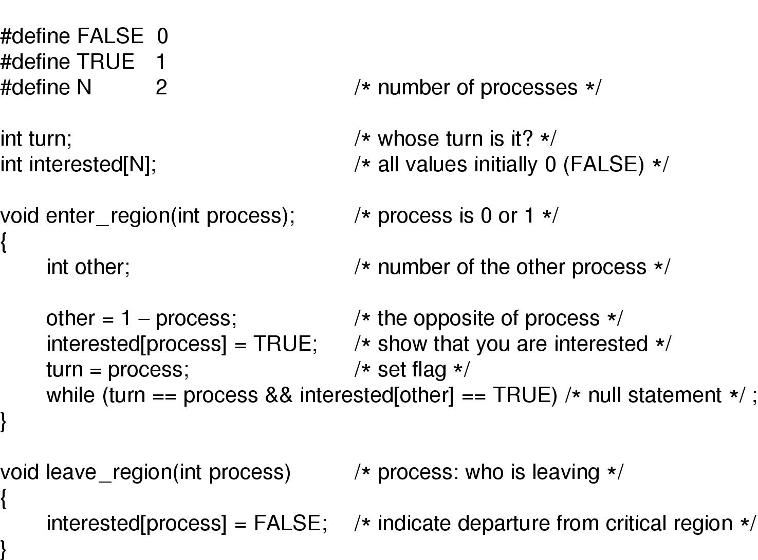
Mutual Exclusion with Busy Waiting (2) : a workable method
Peterson's solution for achieving mutual exclusion

Slide 37
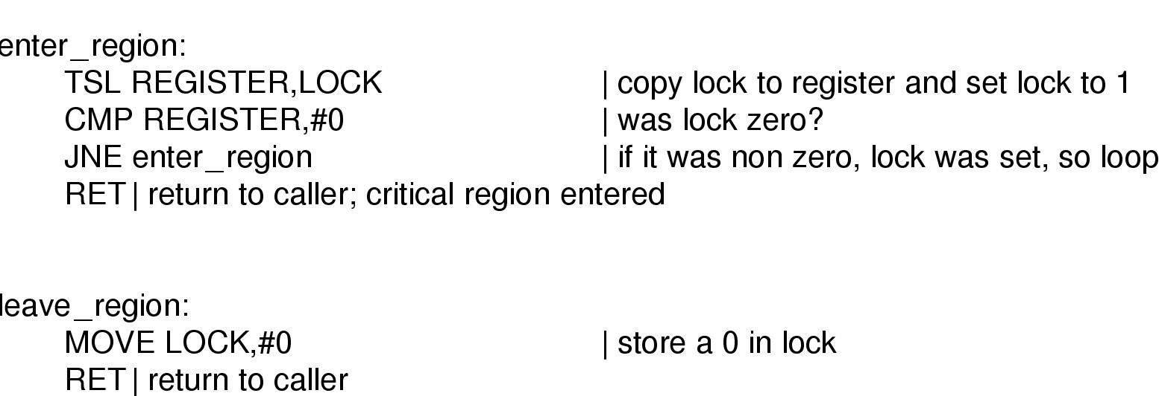
Mutual Exclusion with Busy Waiting (3)
Entering and leaving a critical region using the
TSL instruction

Slide 38
Sleep and wakeup
Drawback of Busy waiting
  A lower priority process has entered critical region
  A higher priority process comes and preempts the lower priority process, it wastes CPU in busy waiting, while the lower priority don’t come out
  Priority inversion/deadlock
Block instead of busy waiting
  Wakeup sleep

Slide 39
Producer-consumer problem
Two processes share a common, fixed-sized buffer
Producer puts information into the buffer
Consumer takes information from buffer
A simple solution

Slide 40
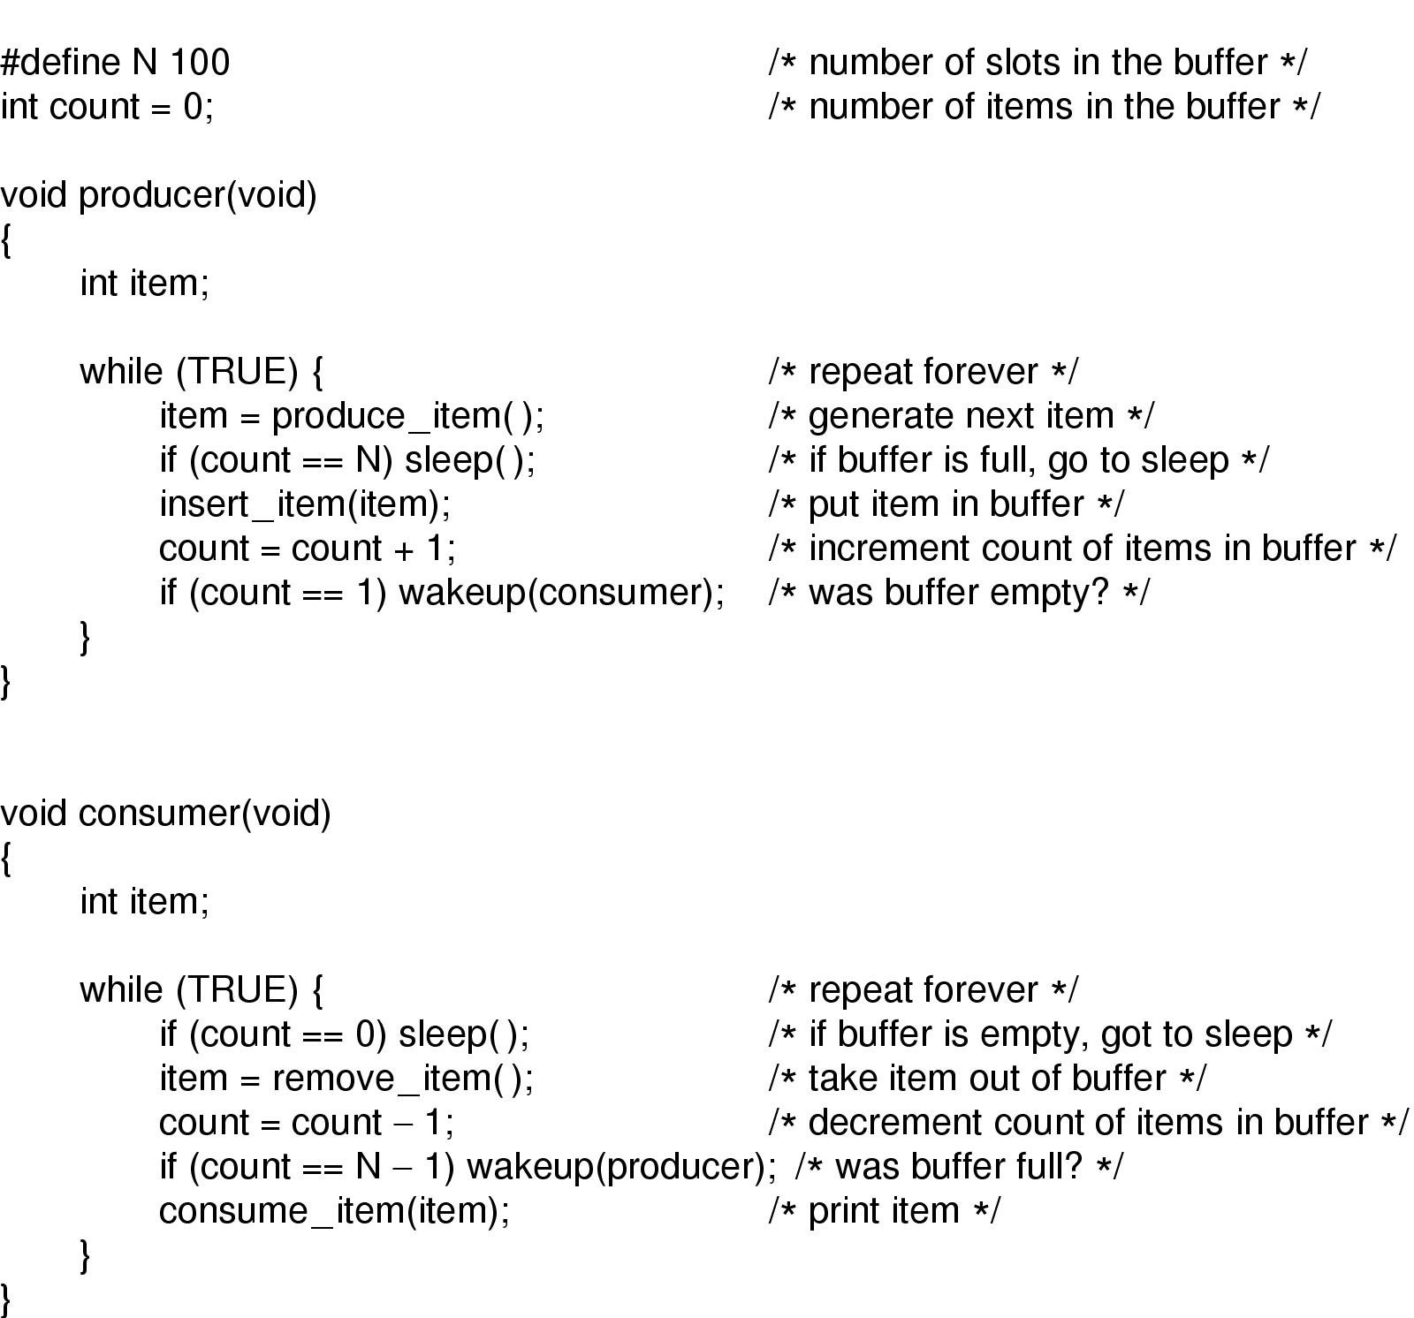
Sleep and Wakeup
Producer-consumer problem with fatal race condition

Slide 41
Producer-Consumer Problem
What can be the problem?
Signal missing
  Shared variable: counter
  Same old problem caused by concurrency
  When consumer read count with a 0 but didn’t fall asleep in time, then the signal will be lost

Slide 42
Semaphore
Proposed by Dijkstra, introducing a new type of variable
Atomic Action
  A single, indivisible action
Down (P)
  Check a semaphore to see whether it’s 0, if so, sleep; else, decrements the value and go on
Up (v)
  Check the semaphore
  If processes are waiting on the semaphore, OS will chose on to proceed, and complete its down
  Consider as a sign of number of resources

Slide 43
Semaphore
Solve producer-consumer problem
  Full: counting the slots that are full; initial value 0
  Empty: counting the slots that are empty, initial value N
  Mutex: prevent access the buffer at the same time, initial value 0 (binary semaphore)
  Synchronization/mutual exclusion

Slide 44
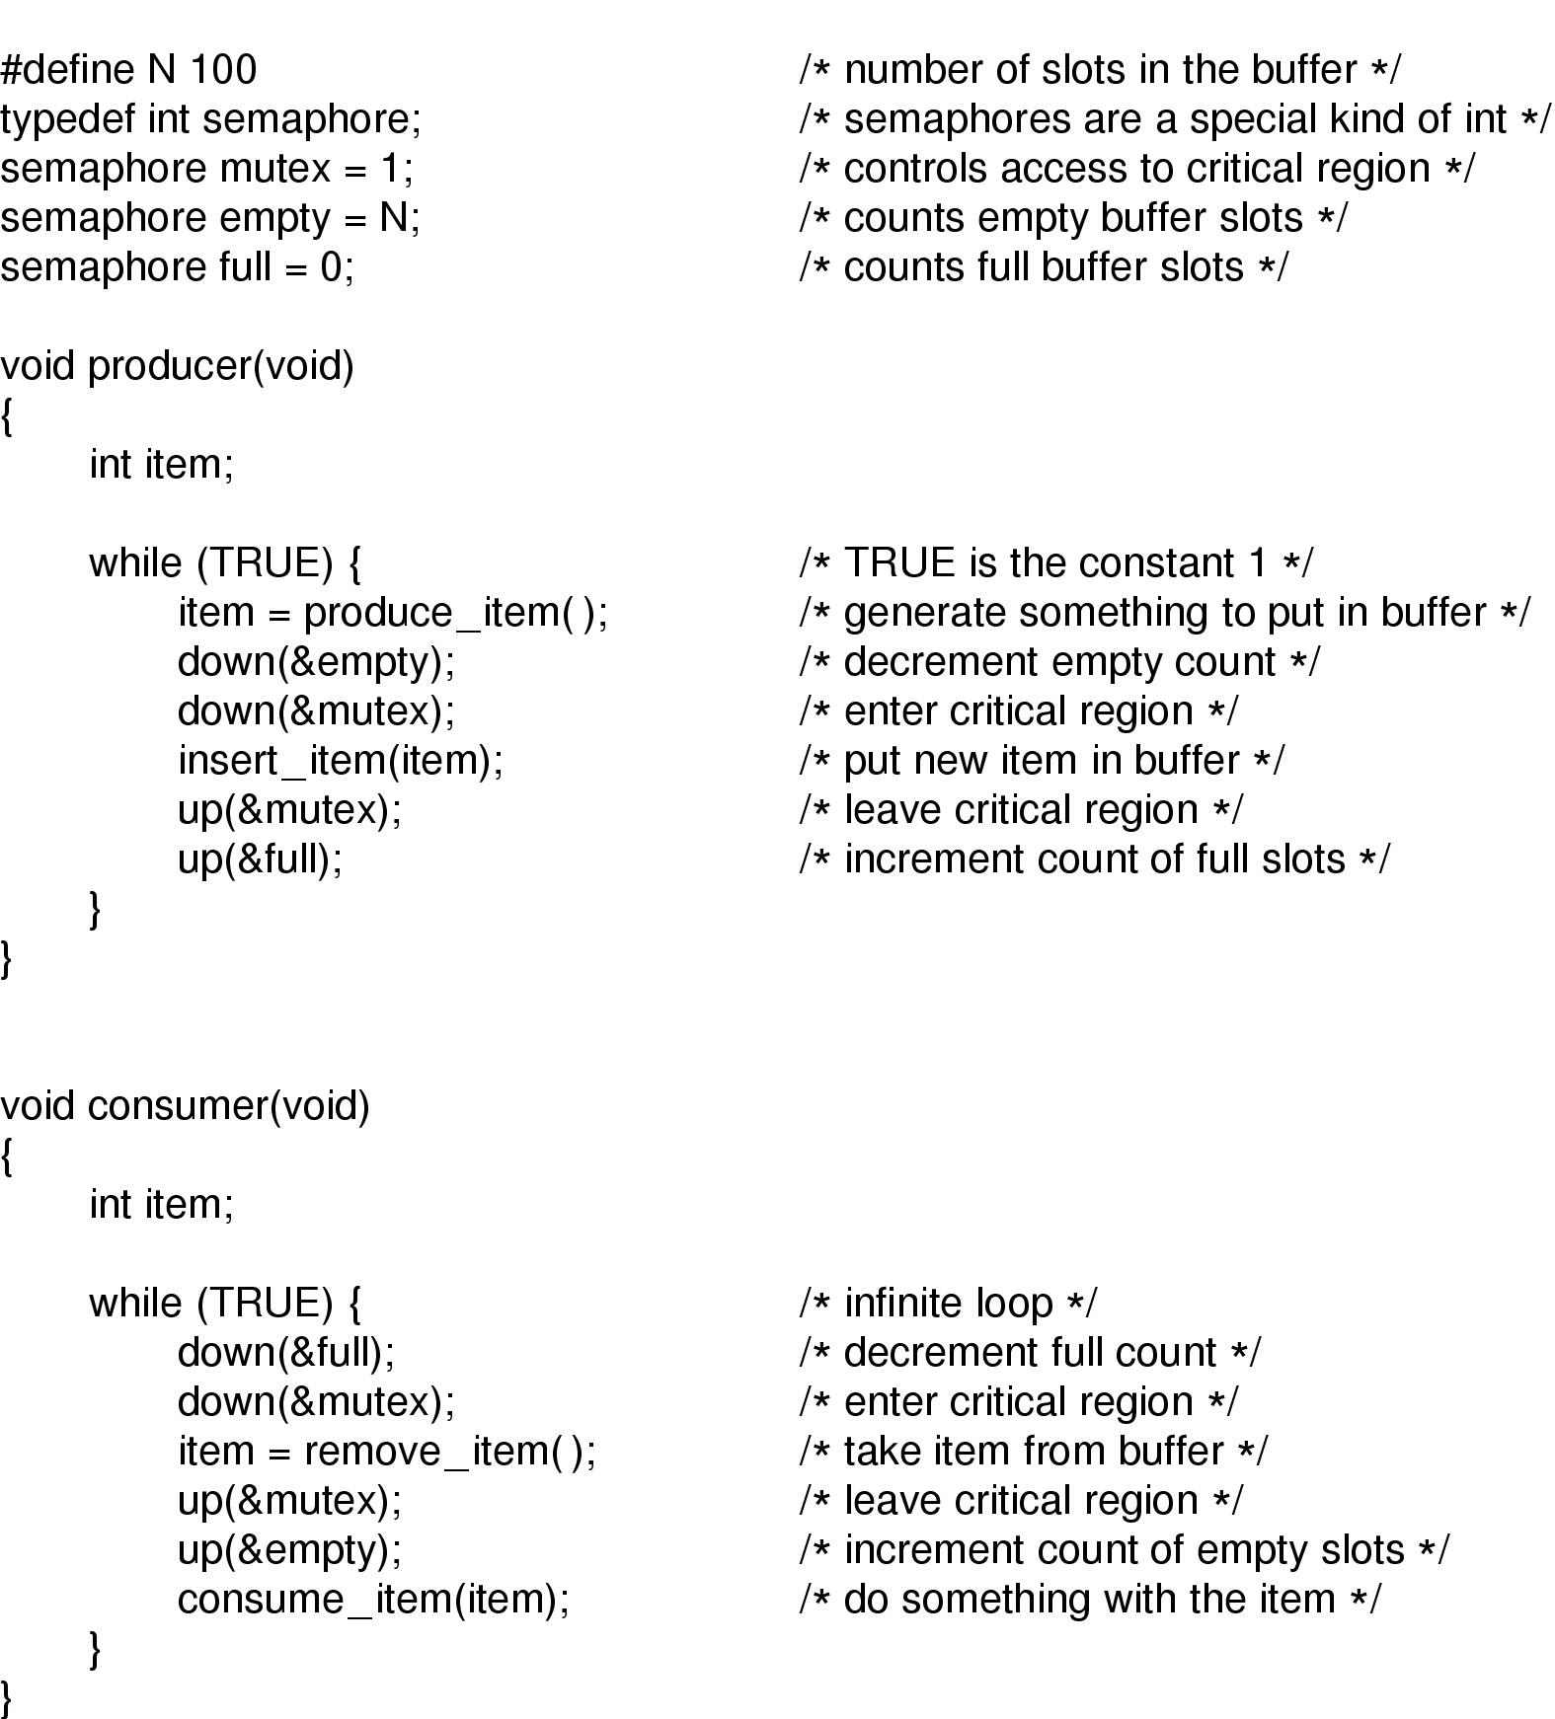
Semaphores
The producer-consumer problem using semaphores

Slide 45
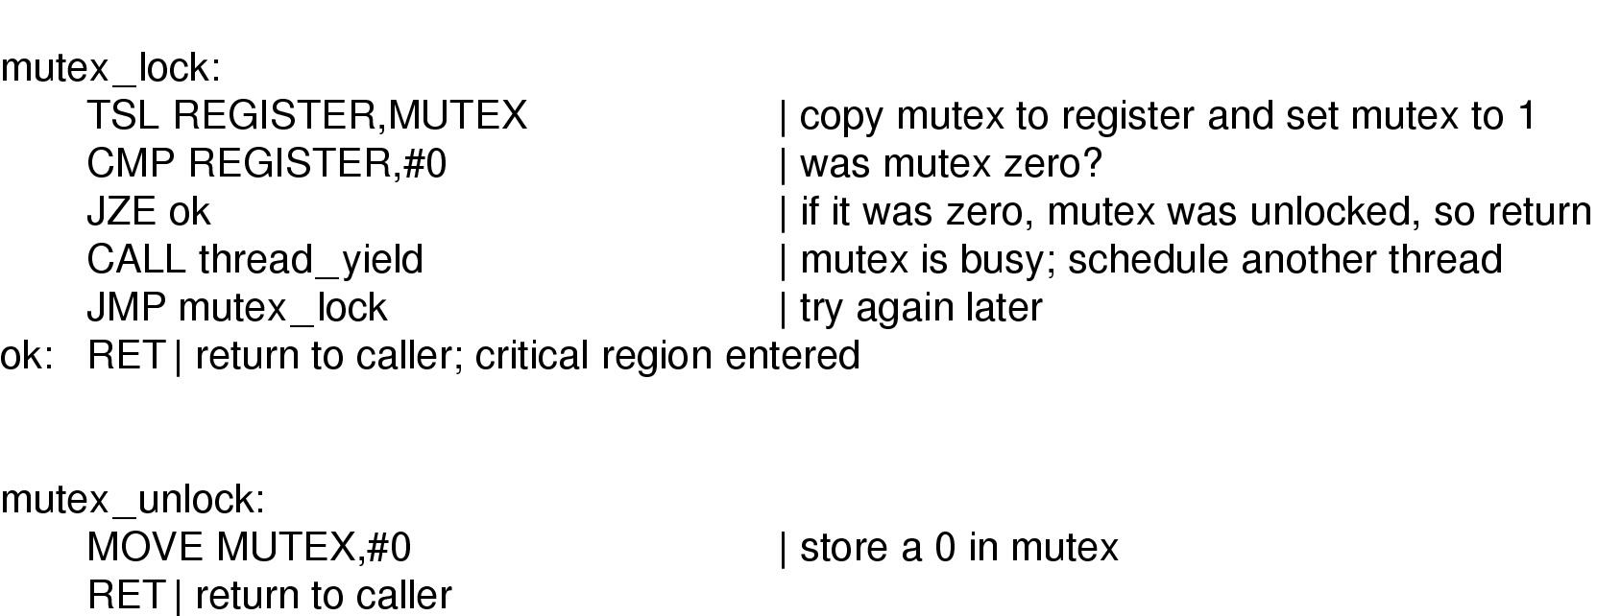
Mutexes
Implementation of mutex_lock and mutex_unlock

Slide 46
A problem
What would happen if the downs in producer’s code were reversed in order?

Slide 47
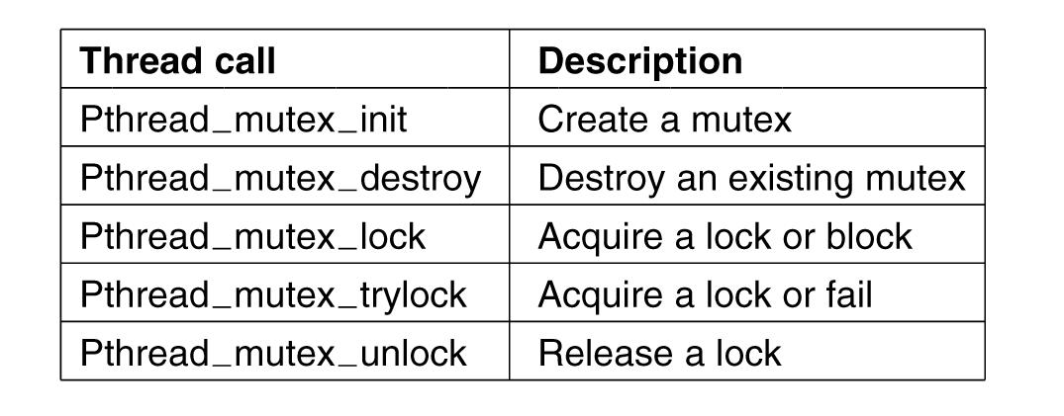
Mutexes in Pthreads (1)
Figure 2-30. Some of the Pthreads calls relating to mutexes.
Tanenbaum, Modern Operating Systems 3 e, (c) 2008 Prentice-Hall, Inc. All rights reserved. 0-13-6006639

Slide 48
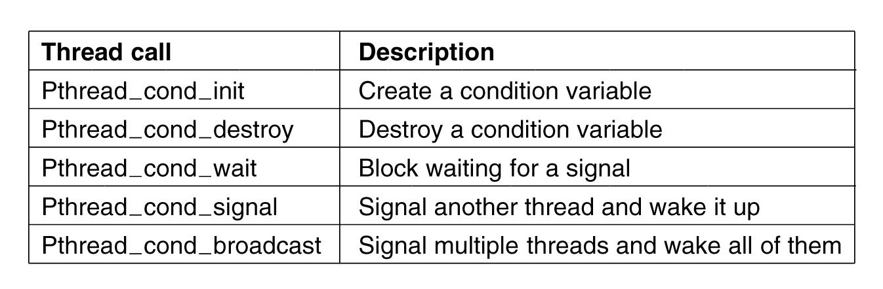
Mutexes in Pthreads (2)
Figure 2-31. Some of the Pthreads calls relating
to condition variables.
Tanenbaum, Modern Operating Systems 3 e, (c) 2008 Prentice-Hall, Inc. All rights reserved. 0-13-6006639

Slide 49
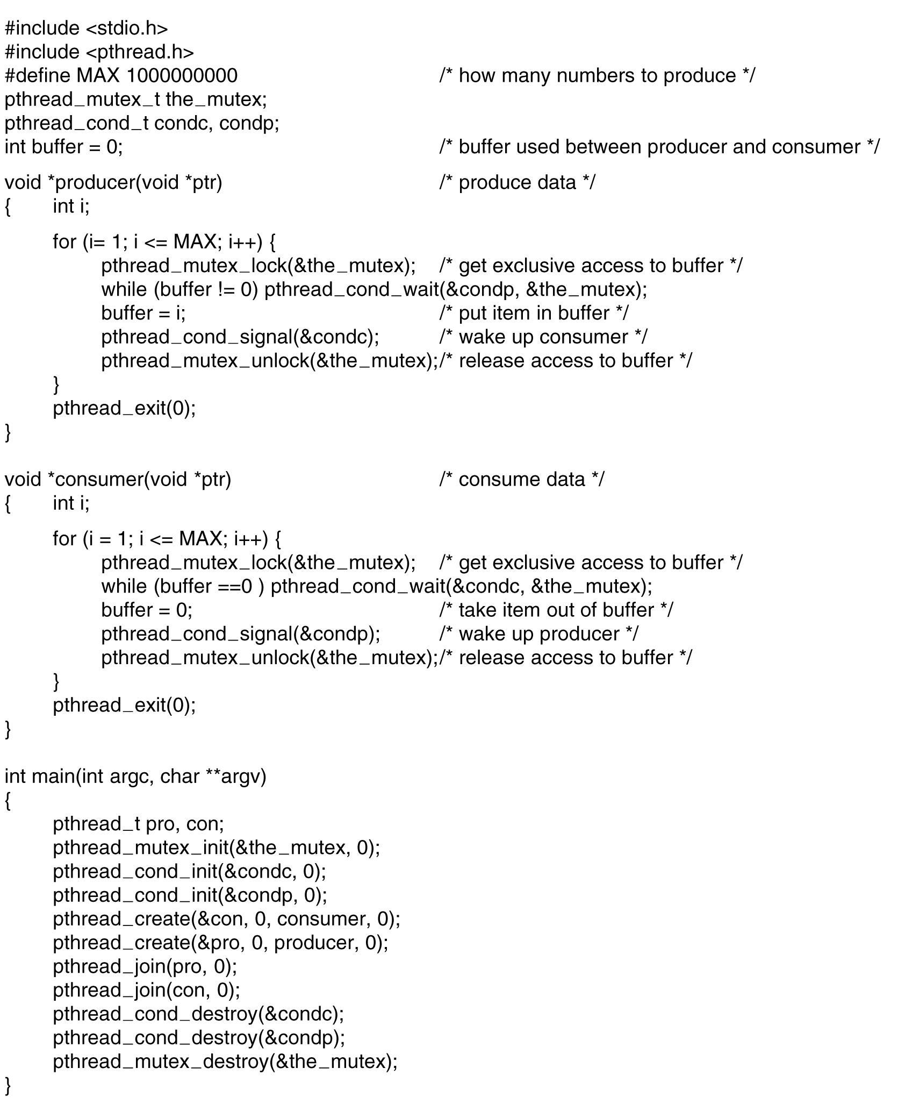
Mutexes in Pthreads (3)
. . .
Figure 2-32. Using threads to solve
the producer-consumer problem.
Tanenbaum, Modern Operating Systems 3 e, (c) 2008 Prentice-Hall, Inc. All rights reserved. 0-13-6006639

Slide 50
Classic IPC Problems
Dining philosopher problem
  A philosopher either eat or think
  If goes hungry, try to get up two forks and eat
Reader Writer problem
  Models access to a database

Slide 51

Dining Philosophers Problem (1)
Figure 2-44. Lunch time in the Philosophy Department.
Tanenbaum, Modern Operating Systems 3 e, (c) 2008 Prentice-Hall, Inc. All rights reserved. 0-13-6006639

Slide 52
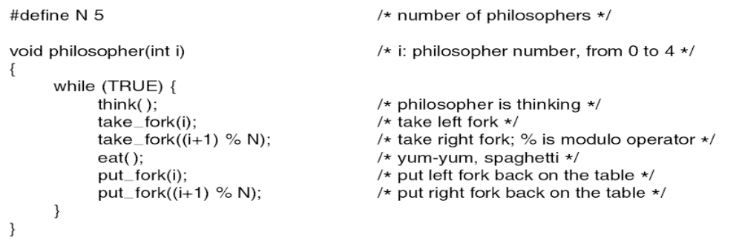
Dining Philosophers Problem (2)
Figure 2-45. A nonsolution to the dining philosophers problem.
Tanenbaum, Modern Operating Systems 3 e, (c) 2008 Prentice-Hall, Inc. All rights reserved. 0-13-6006639

Slide 53
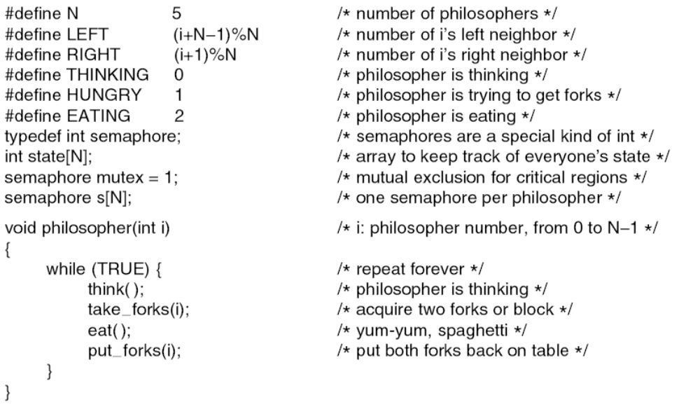
Dining Philosophers Problem (3)
. . .
Figure 2-46. A solution to the dining philosophers problem.
Tanenbaum, Modern Operating Systems 3 e, (c) 2008 Prentice-Hall, Inc. All rights reserved. 0-13-6006639

Slide 54
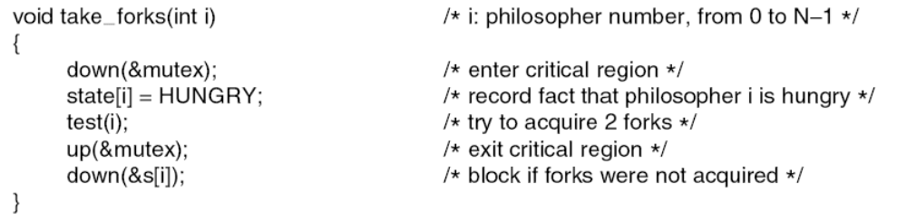
Dining Philosophers Problem (4)
. . .
. . .
Figure 2-46. A solution to the dining philosophers problem.
Tanenbaum, Modern Operating Systems 3 e, (c) 2008 Prentice-Hall, Inc. All rights reserved. 0-13-6006639

Slide 55
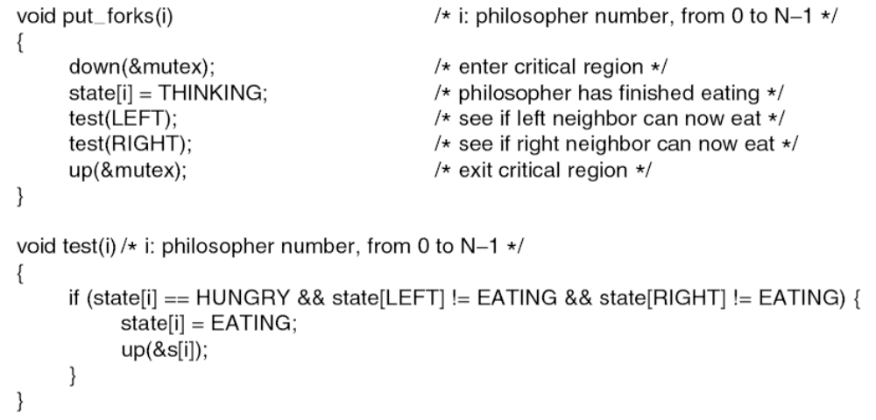
Dining Philosophers Problem (5)
. . .
Figure 2-46. A solution to the dining philosophers problem.
Tanenbaum, Modern Operating Systems 3 e, (c) 2008 Prentice-Hall, Inc. All rights reserved. 0-13-6006639

Slide 56
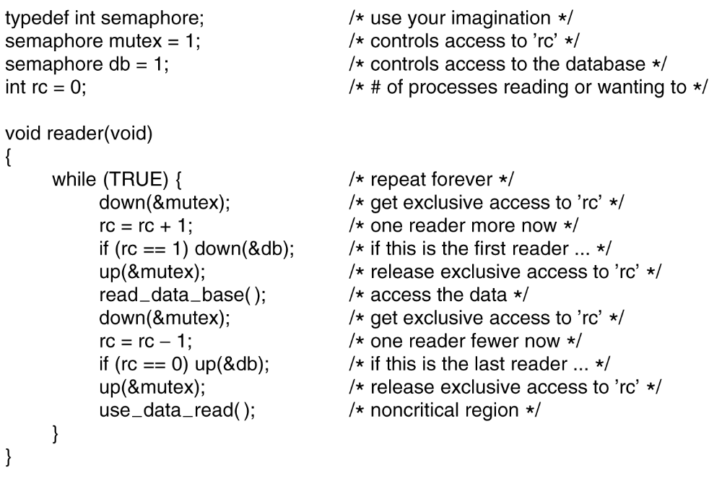
The Readers and Writers Problem (1)
. . .
Figure 2-47. A solution to the readers and writers problem.
Tanenbaum, Modern Operating Systems 3 e, (c) 2008 Prentice-Hall, Inc. All rights reserved. 0-13-6006639

Slide 57
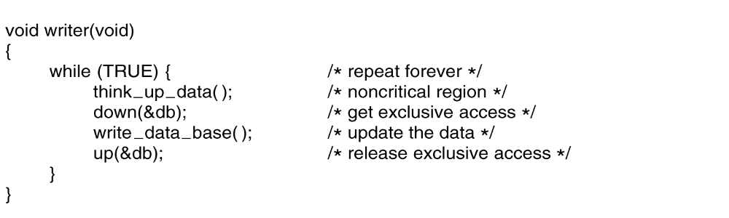
The Readers and Writers Problem (2)
. . .
Figure 2-47. A solution to the readers and writers problem.
Tanenbaum, Modern Operating Systems 3 e, (c) 2008 Prentice-Hall, Inc. All rights reserved. 0-13-6006639

Slide 58
Reader-Writer Problem
What is the disadvantage of the solution?
  Writer faces the risk of starvation

Slide 59
scheduling
Which process to run next?
When a process is running, should CPU run to its end, or switch between different jobs?
Process switching is expensive
  Switch between user mode and kernel mode
  Current process must be saved
  Memory map must be saved
  Cache flushed and reloaded

Slide 60

Scheduling – Process Behavior
Figure 2-38. Bursts of CPU usage alternate with periods of waiting for I/O. (a) A CPU-bound process. (b) An I/O-bound process.
Tanenbaum, Modern Operating Systems 3 e, (c) 2008 Prentice-Hall, Inc. All rights reserved. 0-13-6006639

Slide 61
Note
When CPU gets faster, processes are getting more I/O bounded
A basic idea is if an I/O bound process wants to run, it should get a change quickly

Slide 62
Concepts
Preemptive algorithm
  If a process is still running at the end of its time interval, it is suspended and another process is picked up
Nonpreemptive
  Picks a process to run and then lets it run till it blocks or it voluntarily releases the CPU

Slide 63
Categories of Scheduling Algorithms
Different environments need different scheduling algorithms
  Batch
    Still in wide use in business world
    Non-preemptive algorithms reduces process switches
  Interactive
    Preemptive is necessary
  Real time
    Processes run quickly and block
Tanenbaum, Modern Operating Systems 3 e, (c) 2008 Prentice-Hall, Inc. All rights reserved. 0-13-6006639

Slide 64
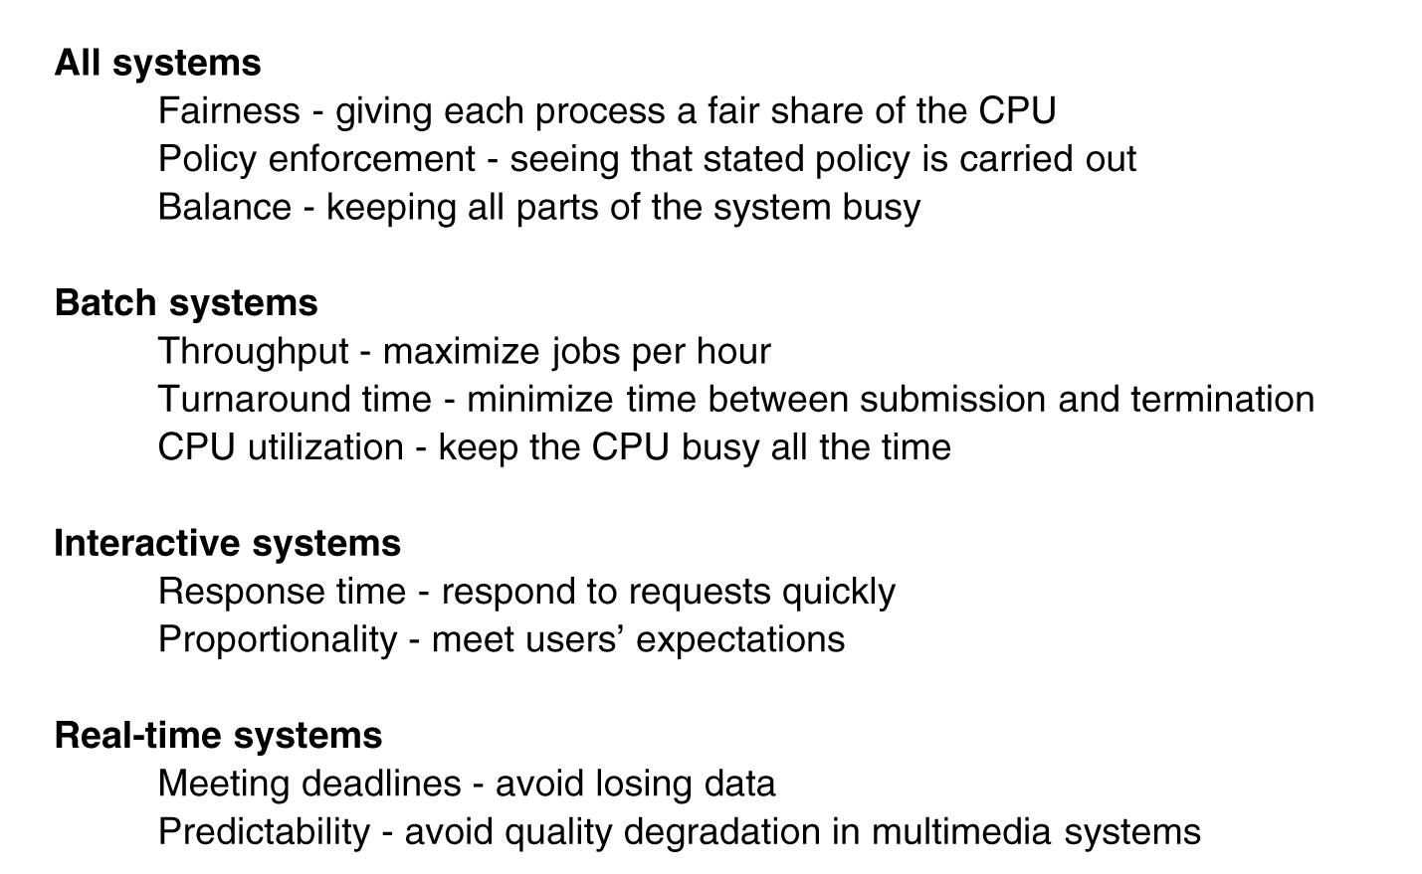
Scheduling Algorithm Goals
Figure 2-39. Some goals of the scheduling algorithm under different circumstances.
Tanenbaum, Modern Operating Systems 3 e, (c) 2008 Prentice-Hall, Inc. All rights reserved. 0-13-6006639

Slide 65
Scheduling in Batch Systems
First-come first-served
Shortest job first
Tanenbaum, Modern Operating Systems 3 e, (c) 2008 Prentice-Hall, Inc. All rights reserved. 0-13-6006639

Slide 66
FCFS
Process | Arrive time | Service time | Start time | Finish time | Turnaround | Weighted turnaround
A | 0 | 1 | 0 | 1 | 1 | 1
B | 1 | 100 | 1 | 101 | 100 | 1
C | 2 | 1 | 101 | 102 | 100 | 100
D | 3 | 100 | 102 | 202 | 199 | 1.99
FCFS is advantageous for which kind of jobs?

Slide 67
FCFS
Disadvantage:
  One CPU-bound process runs for 1 sec at a time
  Many I/O bound processes that use little CPU time but each has to perform 1000 disk reads

Slide 68
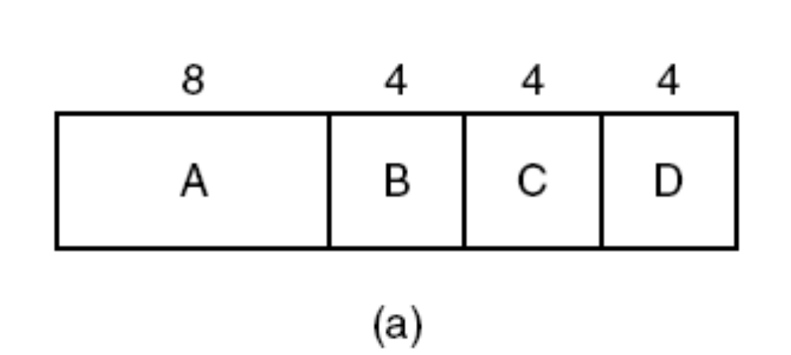
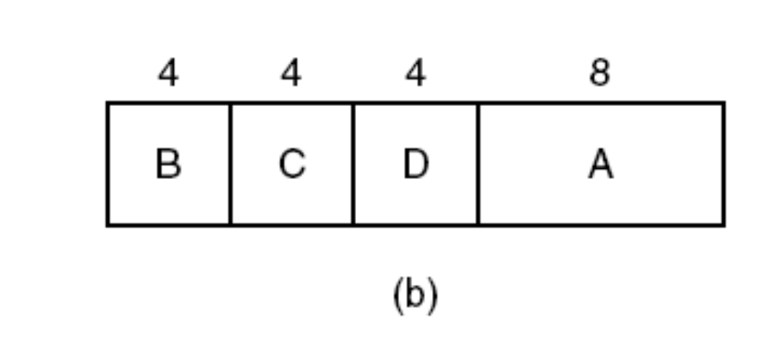
Shortest Job First
Figure 2-40. An example of shortest job first scheduling.
(a) Running four jobs in the original order. (b) Running them in shortest job first order.
Tanenbaum, Modern Operating Systems 3 e, (c) 2008 Prentice-Hall, Inc. All rights reserved. 0-13-6006639

Slide 69
Shortest Job First
Turnaround times: shortest job first is provably optimal
But only when all the jobs are available simultaneously

Slide 70
Shortest job first
 | Process | A | B | C | D | E | average
 | Arrive time | 0 | 1 | 2 | 3 | 4
 | Service Time | 4 | 3 | 5 | 2 | 4
SJF | Finish time | 4 | 9 | 18 | 6 | 13
 | turnaround | 4 | 8 | 16 | 3 | 9 | 8
 | weighted | 1 | 2.67 | 3.1 | 1.5 | 2.25 | 2.1
FCFS | finish | 4 | 7 | 12 | 14 | 18
 | turnaround | 4 | 6 | 10 | 11 | 14 | 9
 | weighted | 1 | 2 | 2 | 5.5 | 3.5 | 2.8
Compare:
  Average Turnaround time
  Short job
  Long job

Slide 71
Scheduling in Interactive Systems
Round-robin scheduling
Priority scheduling
Multiple queues
Shortest process next
Guaranteed scheduling
Lottery scheduling
Fair-share scheduling
Tanenbaum, Modern Operating Systems 3 e, (c) 2008 Prentice-Hall, Inc. All rights reserved. 0-13-6006639

Slide 72
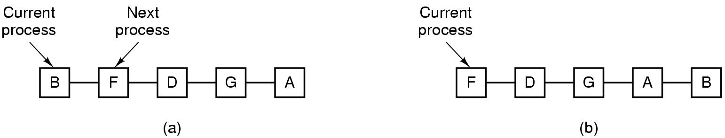
Round-Robin Scheduling
Figure 2-41. Round-robin scheduling.
(a) The list of runnable processes. (b) The list of runnable processes after B uses up its quantum.
Tanenbaum, Modern Operating Systems 3 e, (c) 2008 Prentice-Hall, Inc. All rights reserved. 0-13-6006639

Slide 73
Example: RR with Time Quantum = 20
Arrival time = 0
Time quantum =20
The Gantt chart is
Typically, higher average turnaround than SJF, but better response
Process | Burst Time
P1 | 53
P2 | 17
P3 | 68
p4 | 24
P₁
P₂
P₃
P₄
P₁
P₃
P₄
P₁
P₃
P₃
0
20
37
57
77
97
117
121
134
154
162

Slide 74
Size of time quantum
The performance of RR depends heavily on the size of time quantum
Time quantum
  Too big， = FCFS
  Too small:
    Hardware: Process sharing
    Software: context switch, high overhead, low CPU utilization
  Must be large with respect to context switch

Slide 75
Context switch
If the quantum is 4msec, and context switch is 1msec, then 20% of CPU time is wasted
If the quantum if 100msec, the wasted time is 1%, but less responsive
A quantum around 20-50 msec is reasonable

Slide 76
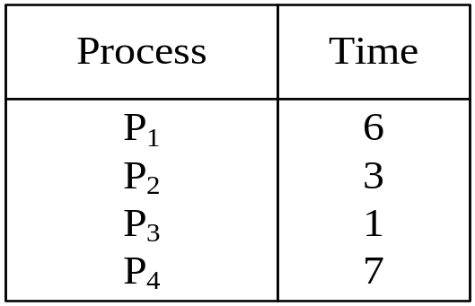
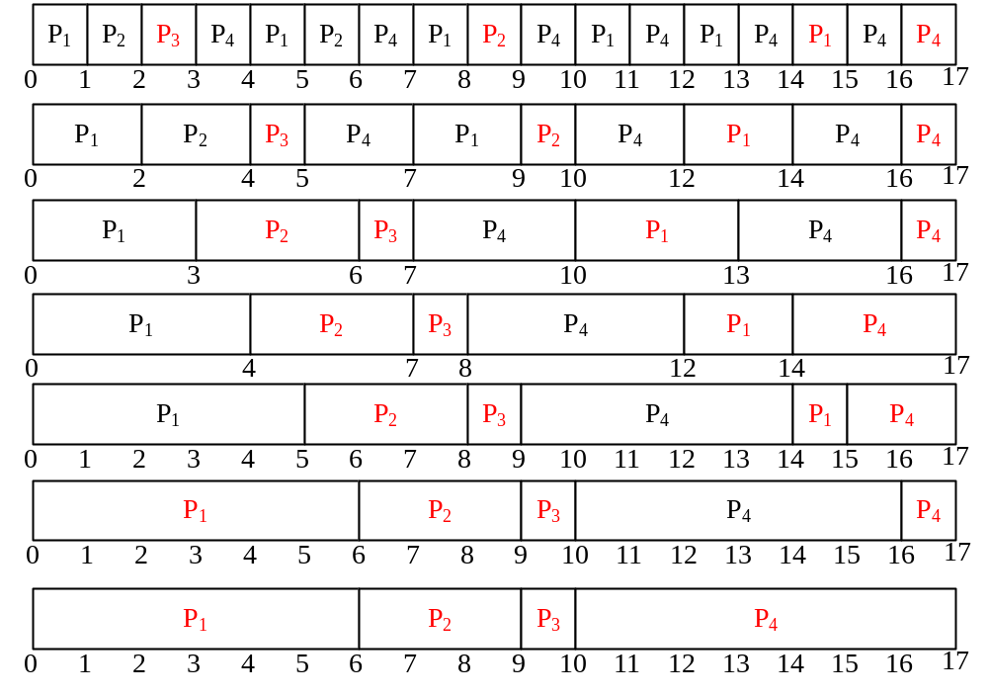
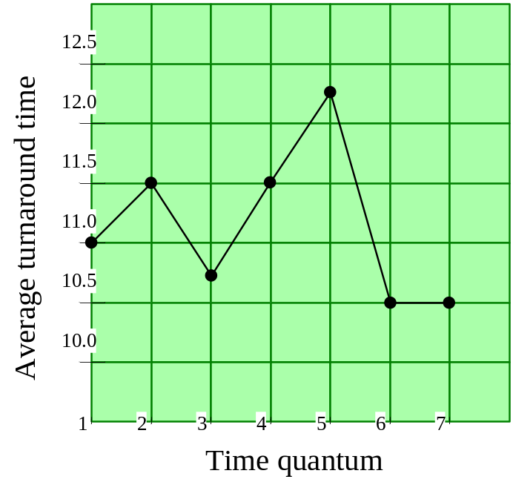
Turnaround Time Varies With The Time Quantum
Will the average turnaround time improve as q increase?
80% CPU burst should be shorter than q

Slide 77
Priority scheduling
Each priority has a priority number
The highest priority can be scheduled first
If all priorities equal, then it is FCFS

Slide 78
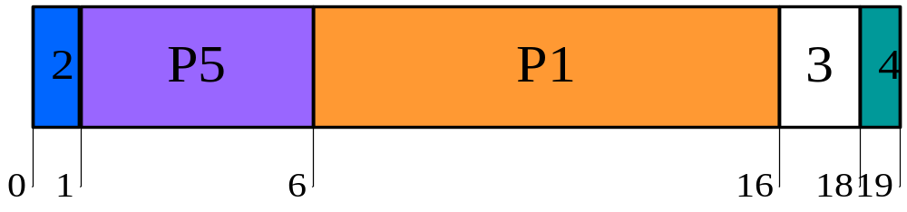
Example
Process | Burst Time | Priority
P1 | 10 | 3
P2 | 1 | 1
P3 | 2 | 3
P4 | 1 | 4
P5 | 5 | 2
E.g.:
Priority (nonpreemprive)
Average waiting time
= (6 + 0 + 16 + 18 + 1) /5 = 8.2

Slide 79
Multiple Queues
CTSS
  Only one process in memory
  It is wise to give large quantum to CPU-bound process and small quantum to interactive process
  Priority classes
    Highest class run for one quantum; next-highest for two quanta, and so on
    When a process used up its quantum, it will be moved to the next class

Slide 80

Example of Multiple Queues
Three queues:
  Q0 – time quantum 8 milliseconds, FCFS
  Q1 – time quantum 16 milliseconds, FCFS
  Q2 – FCFS

Slide 81
Multiple queues
It is not good for process that firstly CPU-bounded, but later interactive
  Whenever a carriage return was typed at the terminal, the process belonging to the terminal was moved to the highest priority class
  What happened?

Slide 82
Shortest Process Next
In interactive systems, it is hard to predict the remaining time of a process
Make estimate based on past behavior and run the shortest estimated running time
Aging:
  Estimate next value in a series by taking the weighted averaged of the current and previous estimate

Slide 83
Priority inversion
Priority inversion
  When the higher-priority process needs to read or modify kernel data that are currently being accessed by another, lower-priority process
  The high-priority process would be waiting for a lower-priority one to finish

Slide 84
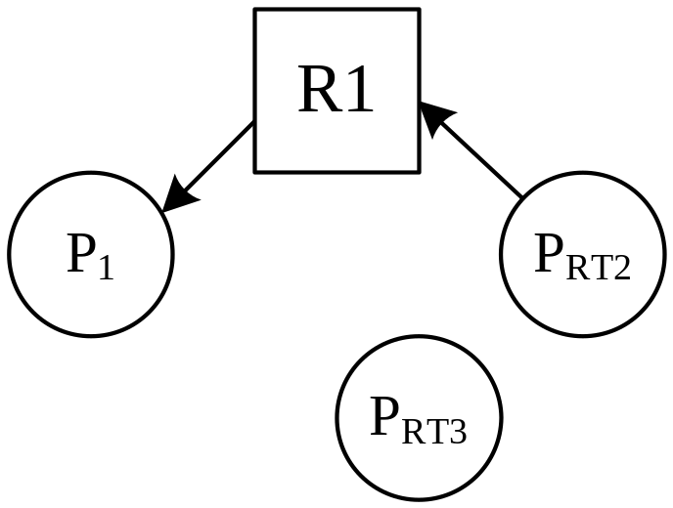
E.g.:
Priority: P₁<P_{RT3}<P_{RT2}
P_{RT3} preempt P₁; P_{RT2} waits for P₁;
➔P_{RT2} waits for P_{RT3}

Slide 85
Priority Inversion in Pathfinder
The landing on Mars of Pathfinder was flawless
But days later, Pathfinder began to experience series of system resets, casing data loss
VxWorks provides preemptive priority scheduling of threads. Tasks on the Pathfinder spacecraft were executed as threads with priorities that were assigned in the usual manner reflecting the relative urgency of these tasks.

Slide 86
Priority Inversion in Pathfinder
"information bus”
  a shared memory area used for passing information between different components of the spacecraft.
bus management task
  ran frequently with high priority to move certain kinds of data in and out of the information bus. Access to the bus was synchronized with mutual exclusion locks (mutexes).
meteorological data gathering task ran as an infrequent, low priority thread, used the information bus to publish its data.
a communications task that ran with medium priority.

Slide 87
Priority Inversion in Pathfinder
What would happen if the (medium priority) communications task to be scheduled during the short interval while the (high priority) information bus thread was blocked waiting for the (low priority) meteorological data thread?
A watchdog would notice that the information bus thread hasn’t been executed for some time; and would reset the system

Slide 88
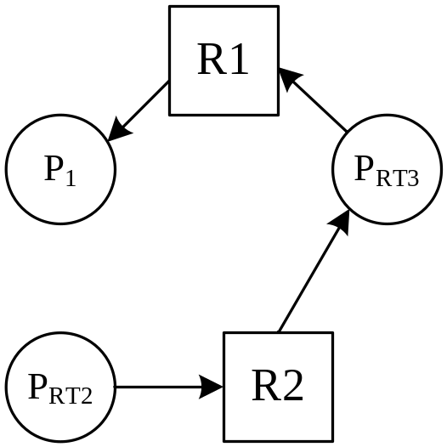
Priority inversion (cont.)
Solution
  Priority-inheritance (lending)
    P_{RT2} lends its priory to P₁, thus P_{RT3} could not preempt P₁
Priority inheritance must be transitive
  E.g.:
    Priority: P₁<P_{RT3}<P_{RT2}

Slide 89
Priority Inversion
Ceiling Protocol
  One way to solve priority inversion is to use the priority ceiling protocol, which gives each shared resource a predefined priority ceiling.
  When a task acquires a shared resource, the task is hoisted (has its priority temporarily raised) to the priority ceiling of that resource.
  The priority ceiling must be higher than the highest priority of all tasks that can access the resource, thereby ensuring that a task owning a shared resource won't be preempted by any other task attempting to access the same resource.
  When the hoisted task releases the resource, the task is returned to its original priority level.

Slide 90
Exercises
Compare reading a file using a single-threaded file server and a multithreaded one.
  It takes 15 msec to get a request for work, dispatch it, and do the rest of the necessary processing, if the data are in the cache
  One-third of the time, it will need disk operation, additional 75 msec is needed
  How many requests/sec can the server handle if it is single threaded? If it is multithreaded?

Slide 91
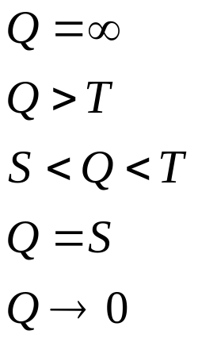
Exercises
Measurements of a certain system have shown that the average process run for a T before blocking on I/O. A process switch requires a time of S. For round-robin scheduling with quantum Q, give the CPU efficiency for each of the following.

Slide 92
Exercise
Five batch jobs A through E, arrive at a computer center at almost the same time, and the estimated running time are 10,6,2,4,and 8 minutes, with priorities 3,5,2,1,4, 5 being the highest. Computer the average turnaround time of the following algorithms.
  Round robin
  Priority scheduling
  FCFS
  Shortest job first

Slide 93
Exercise
The aging algorithm with a=1/2 is being used to predict run times. The previous four runs, from oldest to most recent, are 40, 20,40 and 15 msec. What is the prediction of next time?

Slide 94
Exercise
A process running on CTSS needs 30 quanta to complete. How many times must it be swapped in?

